Slide 1
Operated by Los Alamos National Security, LLC,
for the U.S. Department of Energy
MaRIE X-Ray FEL
Bruce Carlsten
Los Alamos National Laboratory
March 6, 2012
Notes:
1
MaRIE = Matter Radiation Interactions and Extremes, a la Ms. Curie

Slide 2
Overview
What is MaRIE and XFEL Description
  Proposal process (MaRIE 1.0)
Baseline Design Concept
Advanced Design Concepts
  Emittance partitioning example (Thursday: Bishofberger)
  Beam-based seeding (Thursday: Bishofberger, Marksteiner, Yampolsky)
Acknowledgements: Rich Sheffield, Pat Colestock, Kip Bishofberger, Leanne Duffy, Cliff Fortgang, Henry Freund, Quinn Marksteiner, Steve Russell, Rob Ryne, Pete Walstrom, Nikolai Yampolsky
Slide 2
Notes:
2

Slide 3
MaRIE and the proposal process
The Laboratory has defined a signature science facility Matter-Radiation Interactions in Extremes (MaRIE) ~ $2B for full capabilities
NNSA asked the Laboratory to respond (2/15/12) to their call with a trimmed-down facility (MaRIE 1.0) ($B class proposal)
  LANL, LLNL, SNL each responded to NNSA call with multiple proposals – NNSA will develop a future science roadmap based on input from this call
  NNSA may provide a MaRIE ~CD0 sometime in FY13; LANL has internal funds for beginning enabling R&D in FY12
  Work that is presented at this workshop is largely funded by a Los Alamos LDRD project to identify advanced design options
12-GeV electron linac driving 42-keV (0.3Å) XFEL is cornerstone of MaRIE 1.0
Slide 3
Notes:
3

Slide 4
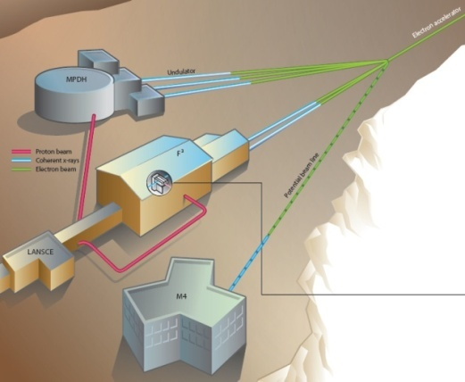
MaRIE builds on the LANSCE facility to provide unique experimental tools to meet future materials science needs
  First x-ray scattering capability at high energy and high repetition frequency with simultaneous charged particle dynamic imaging
  (MPDH: Multi-Probe Diagnostic Hall)
  Unique in-situ diagnostics and irradiation environments beyond best planned facilities
  (F³: Fission and Fusion Materials Facility)
  Comprehensive, integrated resource for materials synthesis and control, with national security infrastructure
  (M4: Making, Measuring & Modeling Materials Facility)
  Accelerator Systems
    Electron Linac w/XFEL
    LANSCE proton accelerator power upgrade
  Experimental Facilities
  Conventional Facilities
MaRIE will provide unprecedented international user resources
Slide 4
Notes:
4

Slide 5
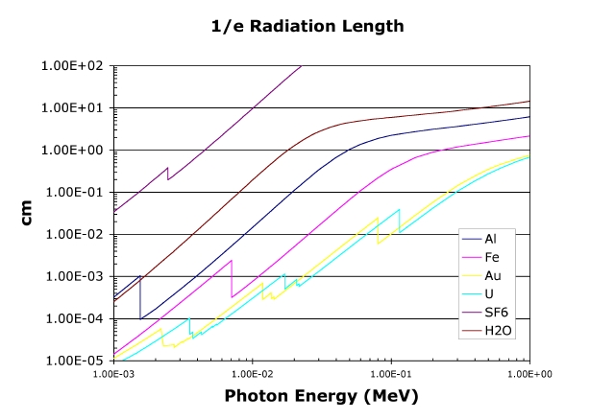
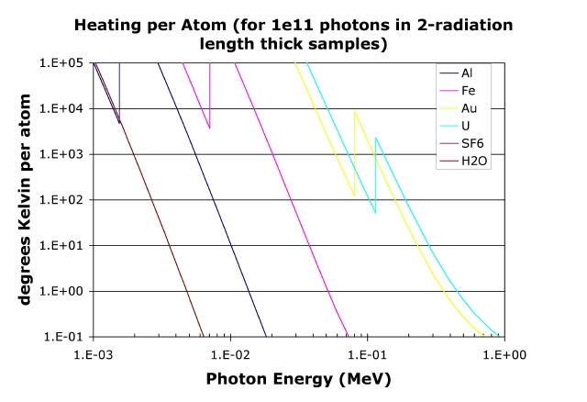
Why 42-keV XFEL?
MaRIE seeks to probe inside multigranular samples of condensed matter that represent bulk performance properties with sub-granular resolution. With grain sizes of tens of microns, "multigranular" means 10 or more grains, and hence samples of few hundred microns to a millimeter in thickness. For medium-Z elements, this requires photon energy of 50 keV or above.
This high energy also serves to reduce the absorbed energy per atom per photon in the probing, and allows multiple measurements on the same sample. Interest in studying transient phenomena implies very bright sources, such as an XFEL.
Slide 5
Notes:
5

Slide 6
MaRIE photon needs can be met by an XFEL (and 10¹⁰ photons and 10⁻³ bandwidth for MaRIE 1.0 XFEL)
 | MPDH | FFF |  | M4
Energy/Range (keV) | 50 | <10 - >50 | 10-400 | 0.1-1.5 | 10-50
Photons per image | 10¹¹ | 10¹¹ | 10⁹ | 10⁹ | 10¹¹
Time scale for single image | 50 fs | >1 s | 0.001 s | 10-500 fs | 50 fs
Energy Bandwidth (∆E/E) | 10⁻⁴ | 10⁻⁴ | 10⁻³ | 10⁻⁴ | 10⁻⁴
Beam divergence | 1 μrad | 1 μrad | < 10 μrad | < 10 μrad | 1 μrad
Trans. coherence (TC) or spatial res. | TC | TC | 1-100 μm | TC | TC
Single pulse # of images/duration | 100/1.5 μs | - | - | - | -
Multiple pulse rep. rate/duration | 120 Hz/day | 0.01 Hz/mo. | 60 Hz/secs | 1 KHz/day | 10 Hz/days
Longitudinal coherence | yes | yes | no | yes | yes
Polarization | linear | linear | no | Linear/circular | linear
Tunability in energy (∆E/E/time) | 2%/pulse | fixed | fixed | 10%/s | 10x/day
Photon energy - set by gr/cm² of sample and atomic number
Photon number for an image - typically set by signal to noise in detector and size of detector
Time scale for an image - fundamentally breaks down to transient phenomena, less than ps, and semi-steady state phenomena, seconds to months
Bandwidth - set by resolution requirements in diffraction and/or imaging
Beam divergence - set by photon number loss due to stand-off of source/detector or resolution loss in diffraction
Source transverse size/transverse coherence - the source spot size will set the transverse spatial resolution, if transversely coherent then this limitation is not applicable so transverse coherence can be traded off with source spot size and photon number
Number of images/rep rate/duration – images needed for single shot experiments/image rep rate/ duration of experiment on sample
Repetition rate - how often full images are required
Longitudinal coherence – 3D imaging
Polarization - required for some measurements
Tunability – time required to change the photon energy a fixed percentage
Slide 6
Notes:
6

Slide 7
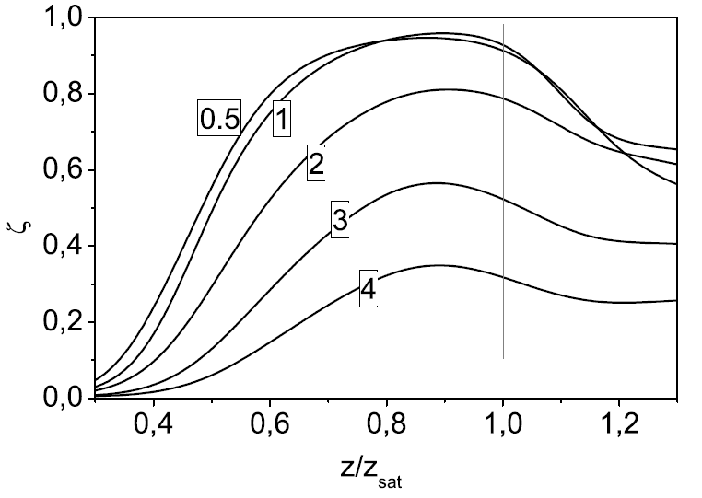
MaRIE 1.0 XFEL requires tiny emittances
Emitance is constrained both by beam energy and transverse coherency:
The choice for beam energy (γ) is dominated by the beam emittance, not wiggler period (which can go down to 1 cm)
Energy diffusion limits how high the beam energy can be (~ 20 GeV), puts a very extreme condition on the beam emittance (ideally ~ 0.1 μm at 12 GeV)
An emittance of 0.1 μm is an emittance ratio of about 1 for the figure above (at 12 GeV). MaRIE 1.0 XFEL baseline emittance (0.2 μm) leads to a transverse coherency of about 0.8.
Slide 7
Notes:
7

Slide 8
The baseline MaRIE 1.0 XFEL is an aggressive extrapolation of LCLS parameters – the bolded parameters are advanced targets
 | UNIT | LCLS | MARIE 1.0 baseline
Wavelength | Å | 1.5 | 0.293
Beam energy | GeV | 14.35 | 12.0
Bunch charge | pC | 250* | 100 (250)
Pulse length (FWHM) | fs | 80* | 30 (75)
Peak current | kA | 3.0* | 3.4
Normalized rms emittance | mm-mrad | 0.3-0.4 | 0.2 (0.1)
Energy spread | % | 0.01 | 0.01
Undulator period | cm | 3 | 1.86
Peak magnetic field | T | 1.25 | 0.70
Undulator parameter, a_{w} |  | 2.48 | 0.86
Gain length, 1D (3D) | m | (3.3)* | (6.0)
Saturation length | m | 65 | 80
Peak power at fundamental | GW | 30* | 8 (17.6)
Pulse energy | mJ | 2.5* | 0.24 (2.4)
# of photons at fundamental |  | 2 x 10¹²* | 2x10¹⁰ (2x10¹¹)
*Y. Ding, HBEB, 11/09
Slide 8

Slide 9
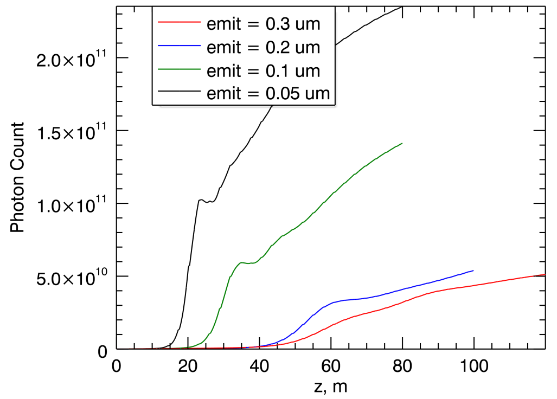
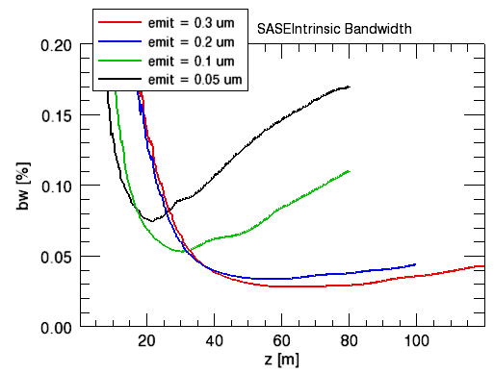
Idealized time-dependent GENESIS simulations motivate baseline design (0.01% energy spread)
ELEGANT simulations indicate that 0.2 micron emittance, 0.01% energy spread reasonable starting points
Consistent with new injector simulations at low bunch charges (100 pC)

Slide 10
MaRIE XFEL baseline and advanced conceptual thinking
L-band photoinjector
S-band accelerator
to 250 MeV
First bunch compressor
S-band accelerator
to 1 GeV
Second bunch compressor
S-band accelerator
to 12 GeV
MaRIE XFEL baseline should be fully upward compatible with advanced design technology insertions:
Emittance partitioning at 250 MeV
Initial modulation at 200 nm before second bunch compressor leads to harmonic current at 0.3 Å
Single-bunch seeding may be better alternative
Injector bunch length and first compressor energy main trades - 10-40 psec to 3 psec (at ~250 MeV) to 30 fsec (at 1 Gev to maintain upward compatibility)
XFEL undulator
- resonant at 0.3 Å
Slide 10
Notes:
10

Slide 11
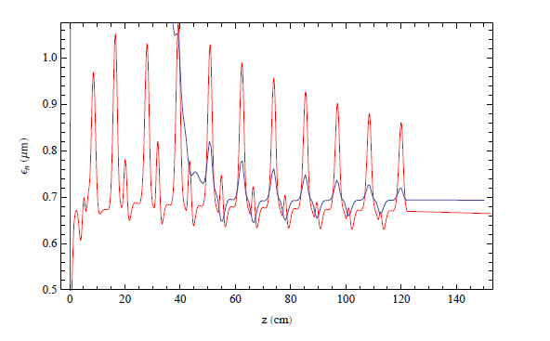
Novel photoinjector design (Rich Sheffield) may directly lead to emittances of 0.1 micron for 100 pC (with thermal component)
Complex tailoring of longitudinal bunch profile leads to more uniform fields, less wavebreaking and significantly better emittance compensation
Motivated by PITZ photoinjector scaling:
Moving from PARMELA (red) to OPAL (blue) simulations for higher fidelity

Slide 12
2nd BC at 1 GeV: ELEGANT simulations assume 0.15 micron initial emittance and 500 eV initial beam energy (at 30 psec) (double EEX design motivated by Zholents)
Dipoles
Octupole
70:1 Telescope
Sextupole and lens
RF cavity
Initial:
ε_{x}= 0.15 μm σ_{x}= 386 μm
ε_{z}= 92.6 μm σ_{z}= 400 μm
(3-psec FWHM)
Final longitudinal phase space
(12 GeV)
Octupole is able to straighten longitudinal phase space
After octupole:
ε_{x}= 47.8 μm σ_{x}= 5060 μm
ε_{z}= 0.155 μm σ_{z}= 25.2 μm
Before 2nd EEX:
ε_{x}= 47.8 μm σ_{x}= 75 μm
ε_{z}= 0.155 μm σ_{z}= 25.2 μm
After 1st EEX:
ε_{x}= 92.7 μm σ_{x}= 5060 μm
ε_{z}= 0.169 μm σ_{z}= 25.2 μm
After 2nd EEX:
ε_{x}= 0.170 μm σ_{x}= 318 μm
ε_{z}= 47.8 μm σ_{z}= 4.33 μm (30 fsec FWHM)
Slide 12

Slide 13
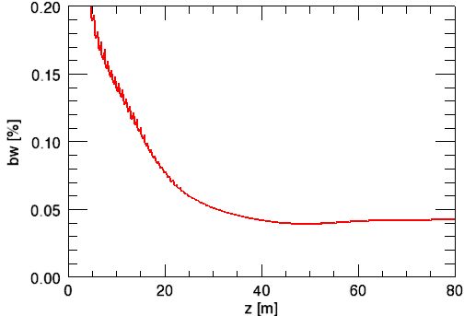
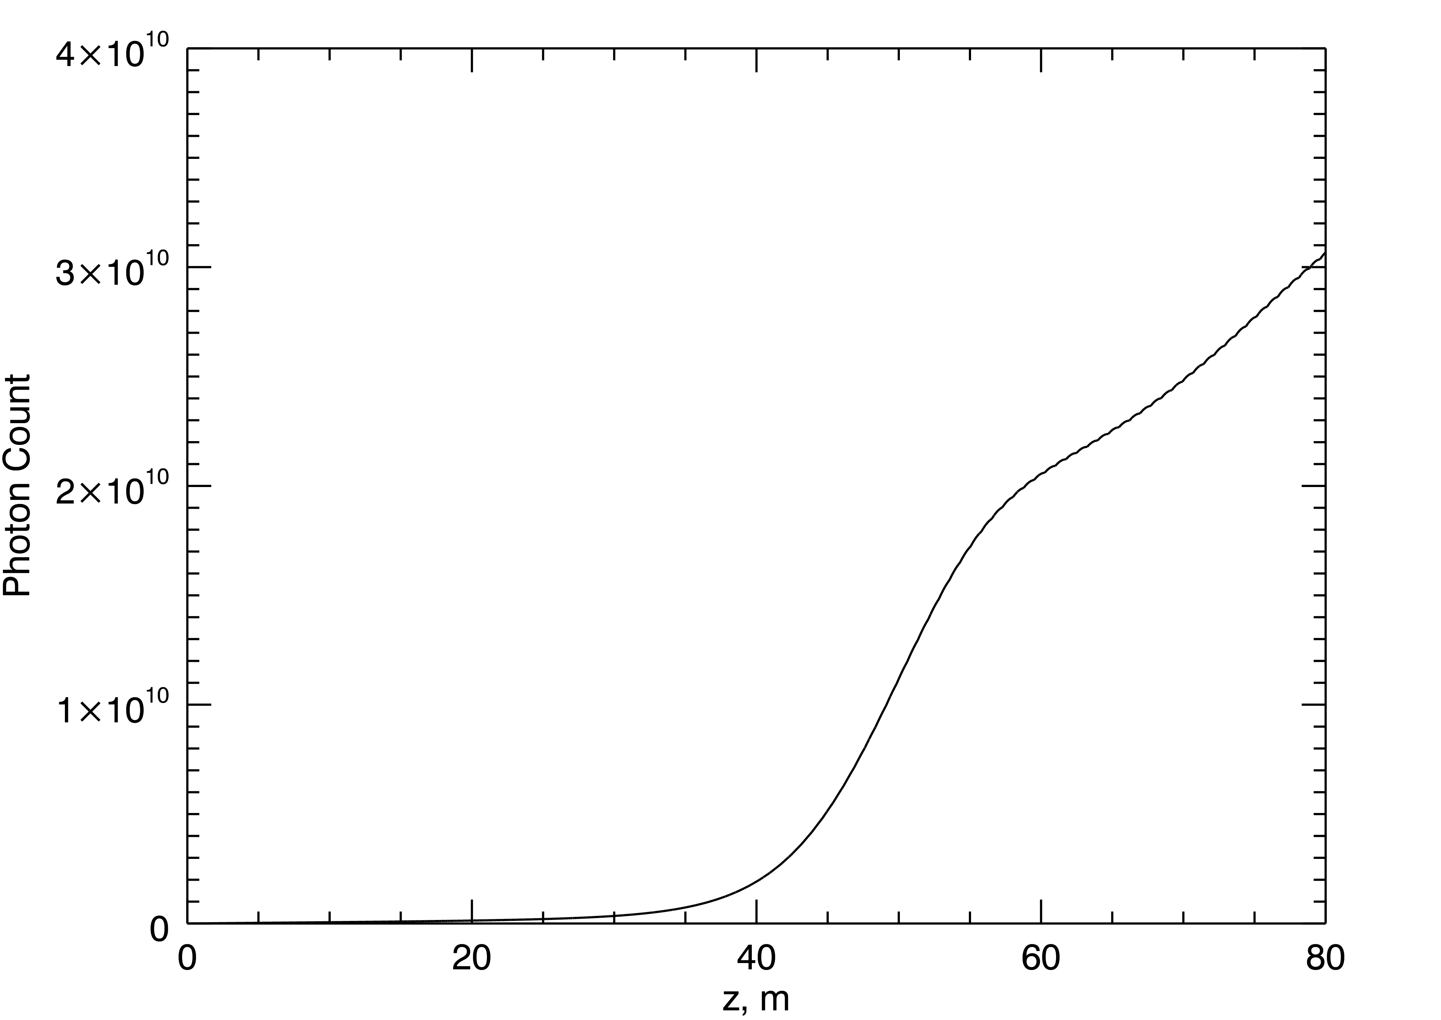
Baseline coupled time-dependent ELEGANT/GENESIS simulations
Some degradation from idealized results due to non-ideal bunch shape
Still, results indicate a nominal 2 10¹⁰ X-rays from 60-m undulator, bandwidth ~ 10⁻³, relatively conservative initial emittance and energy spreads (500 eV is about factor of 2 larger than our PARMELA simulation results, leads to final energy spread of ~ 5 10⁻⁵)
Likely significant increase (factor of 2) with additional tuning, added safety factor
Beam transport reasonable
Slide 13
Notes:
13

Slide 14
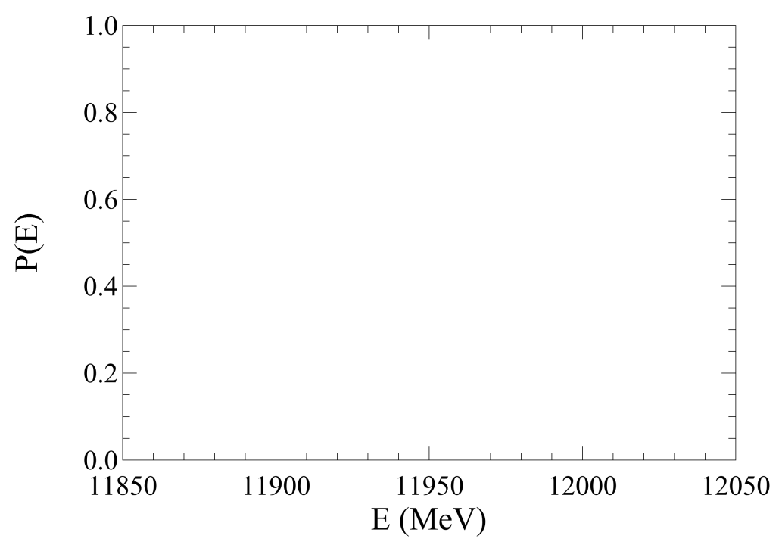
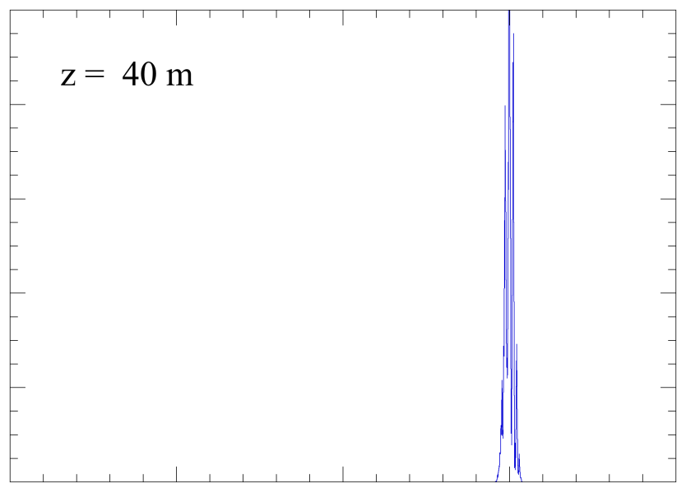
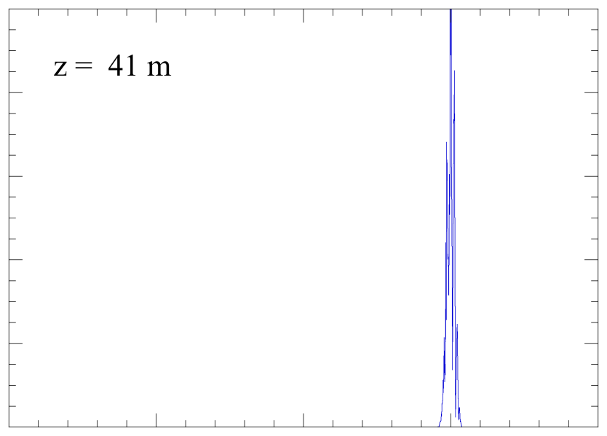
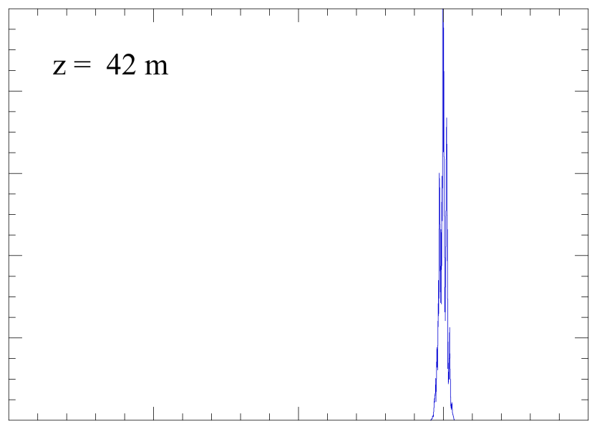
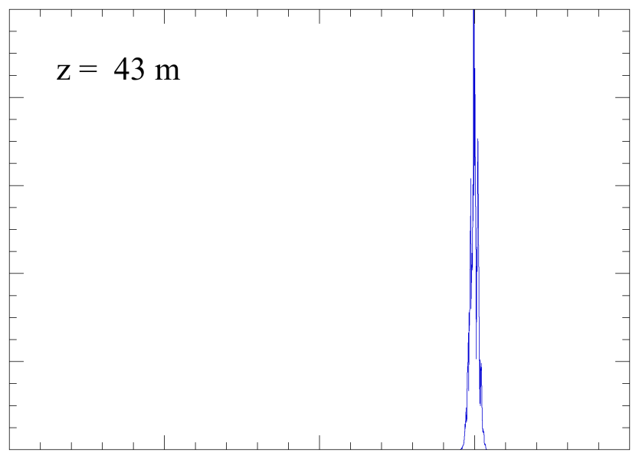
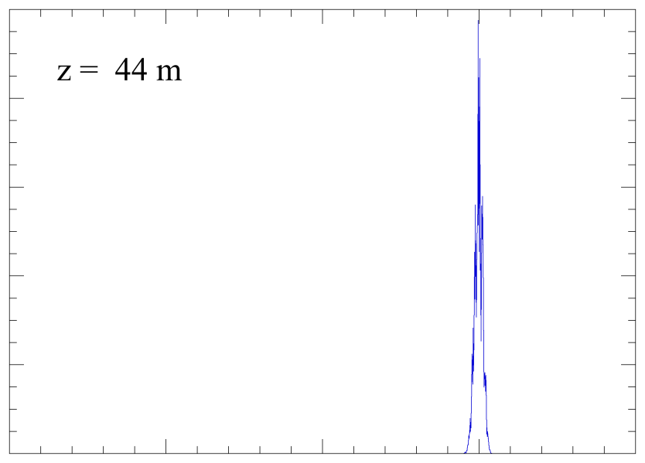
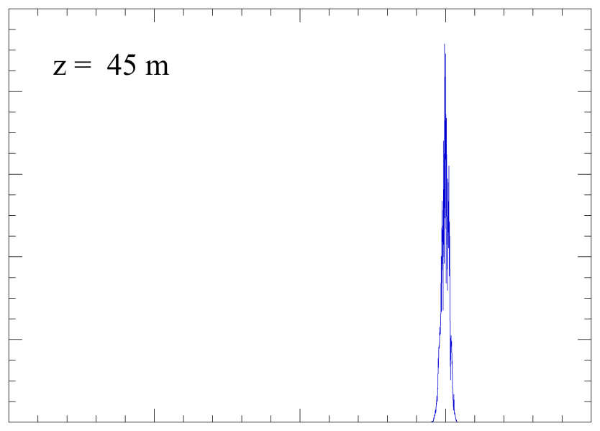
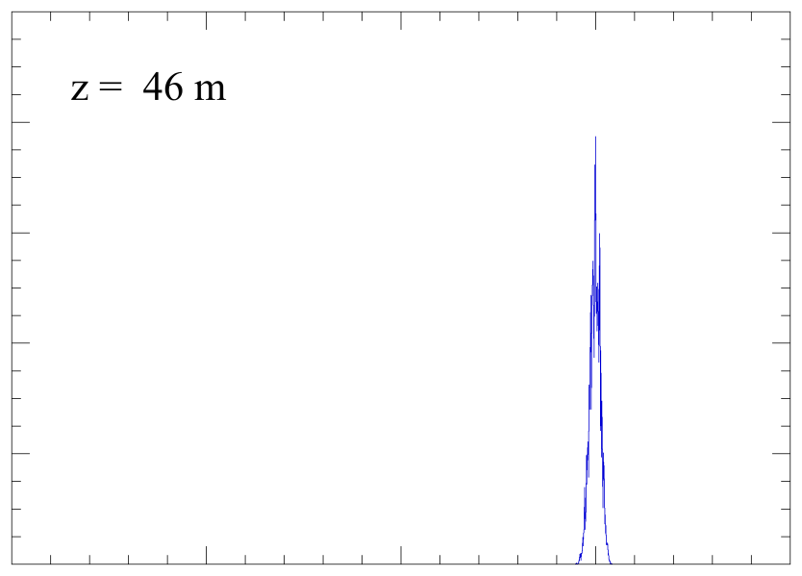
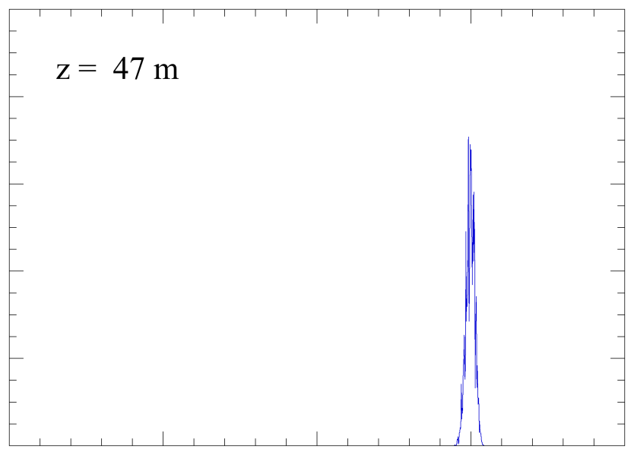
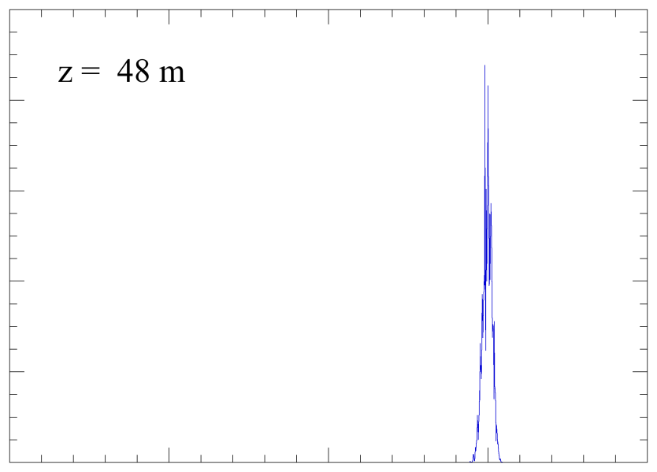
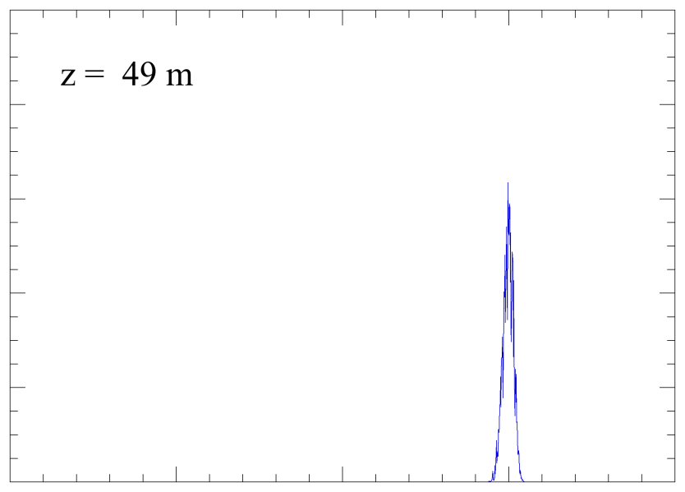
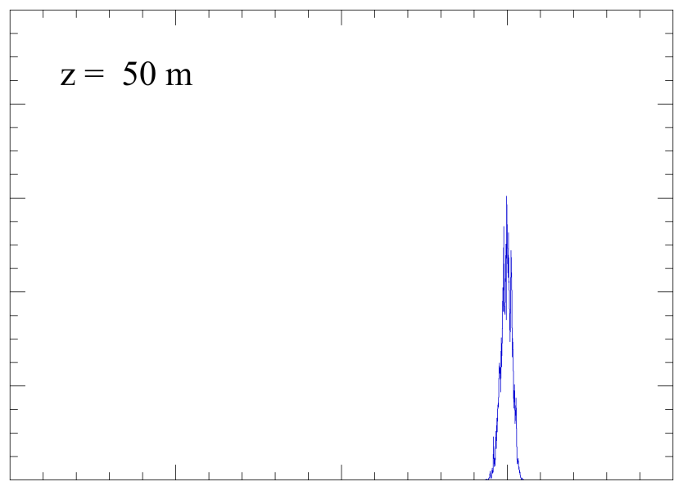

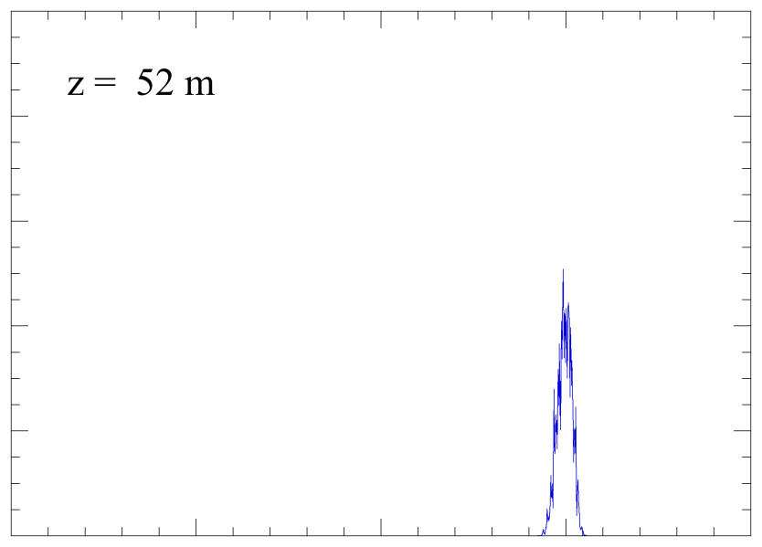
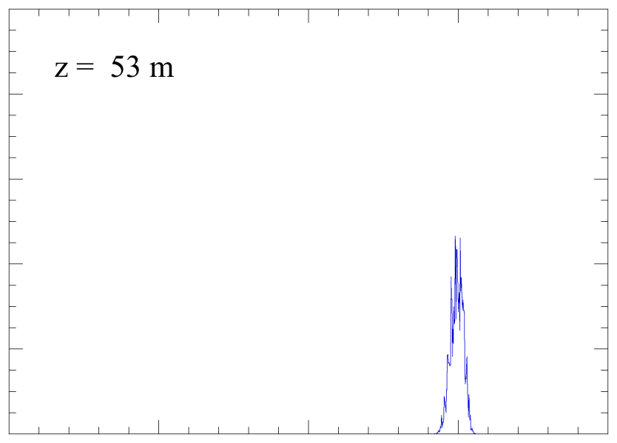
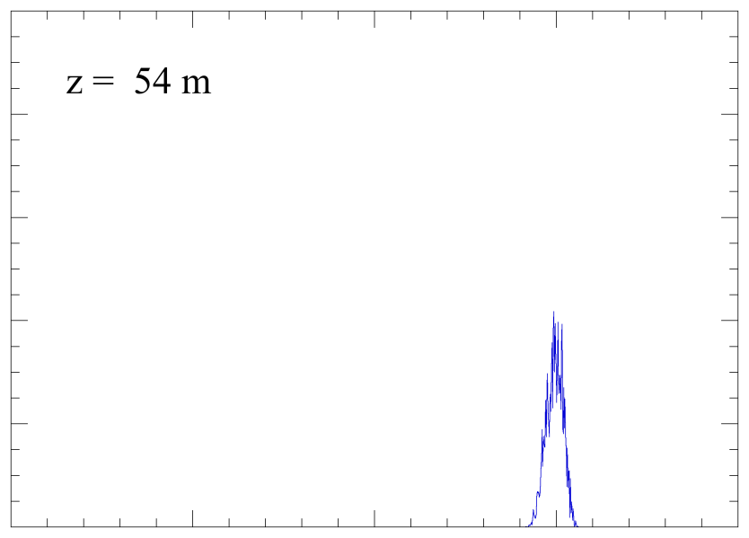
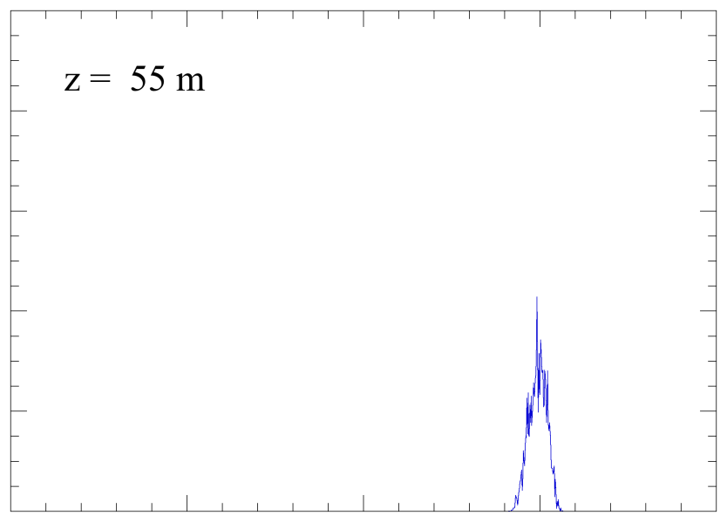
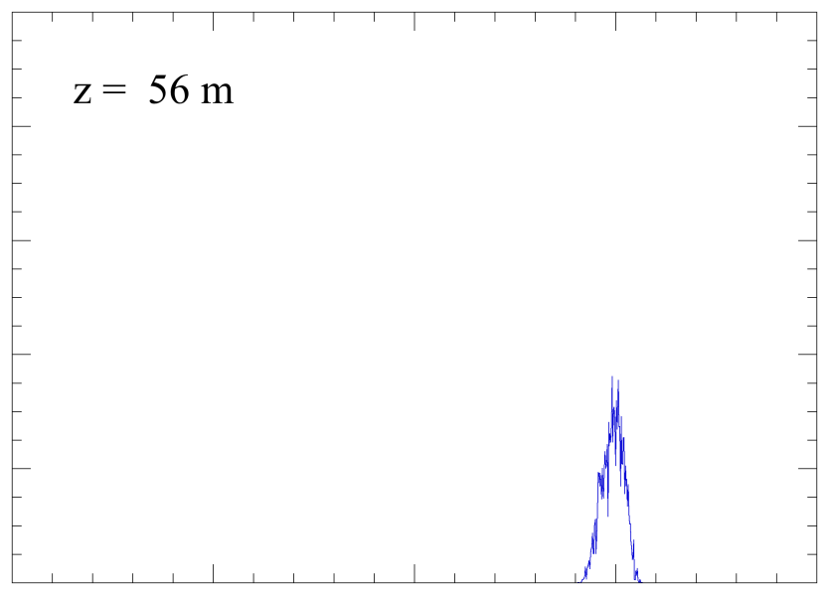
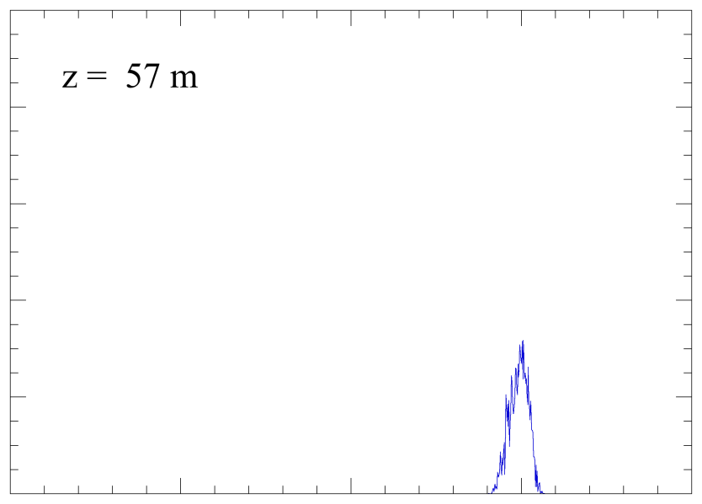
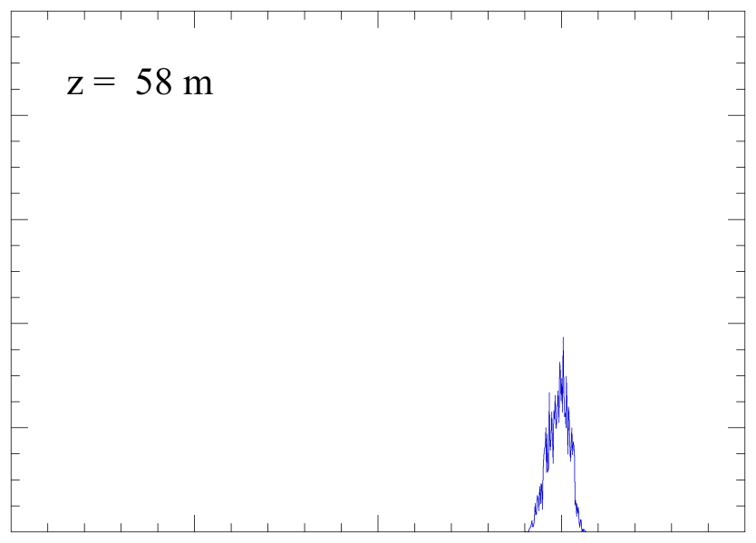

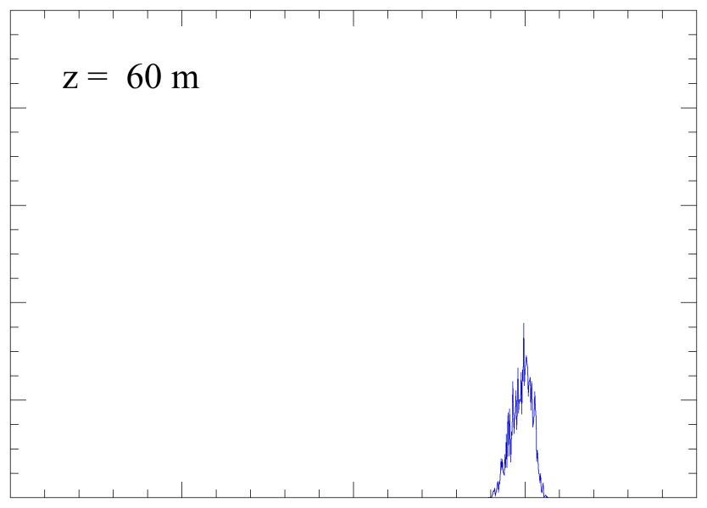
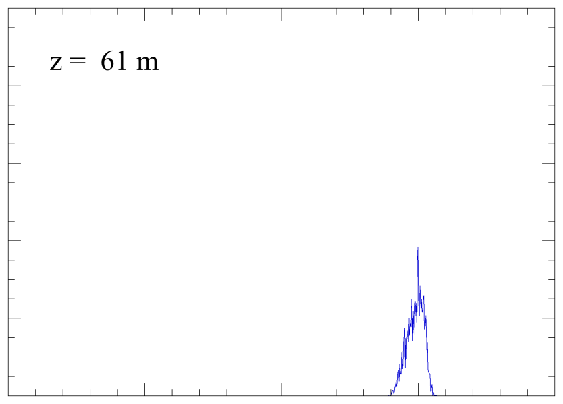

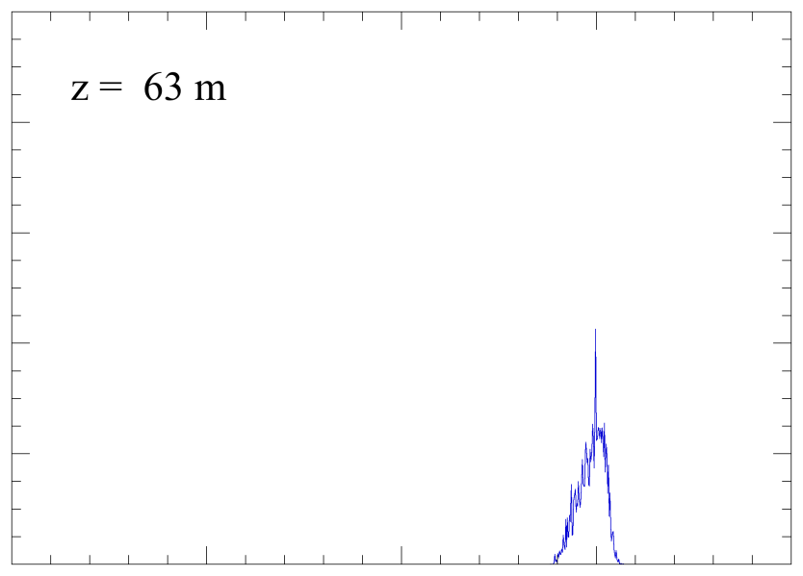
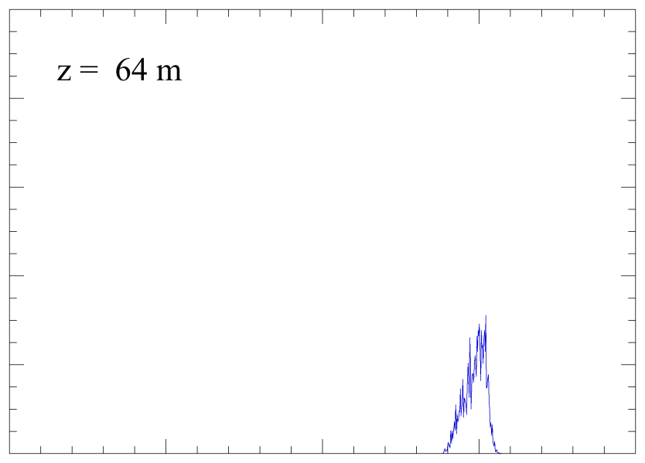
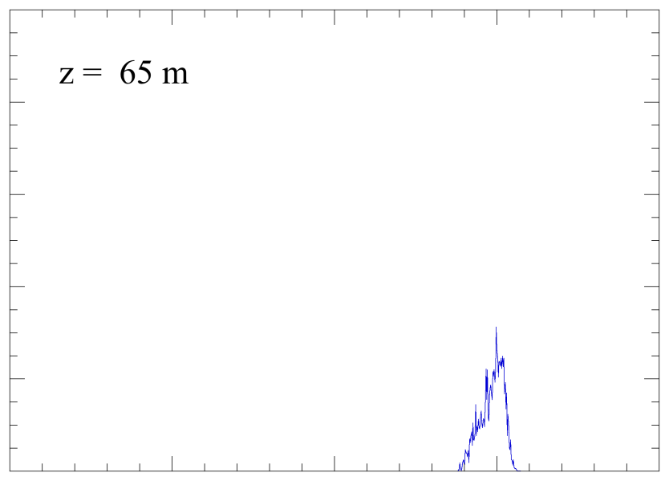
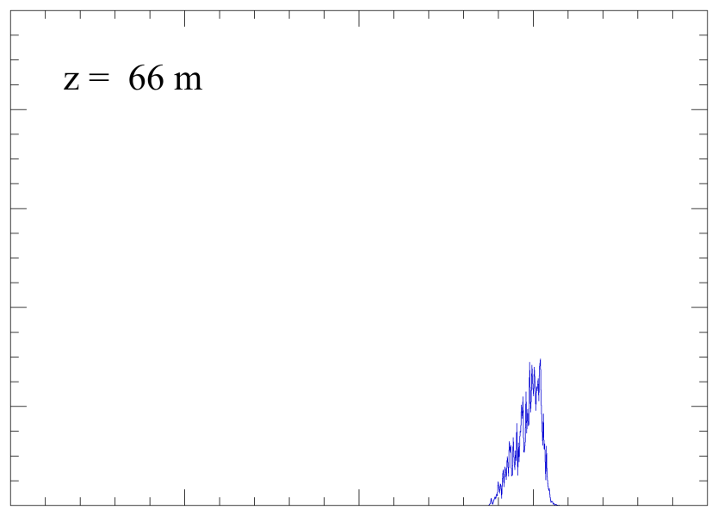
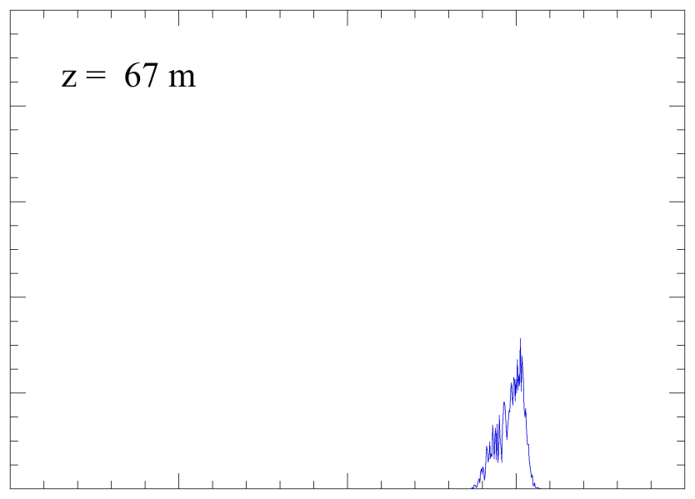
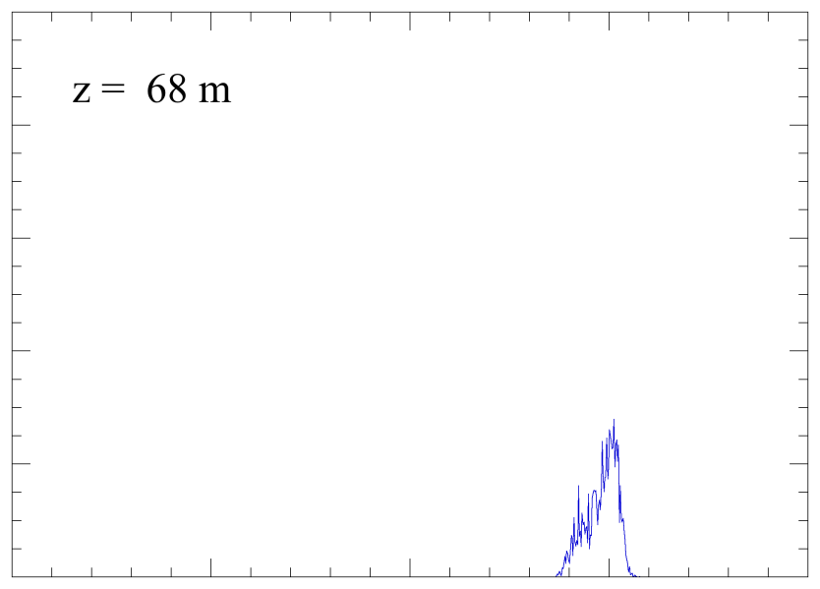
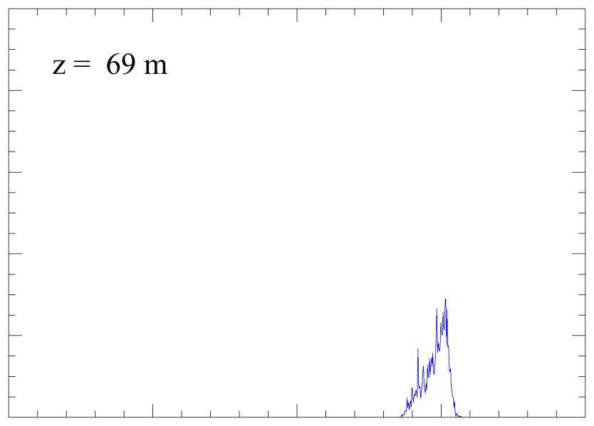
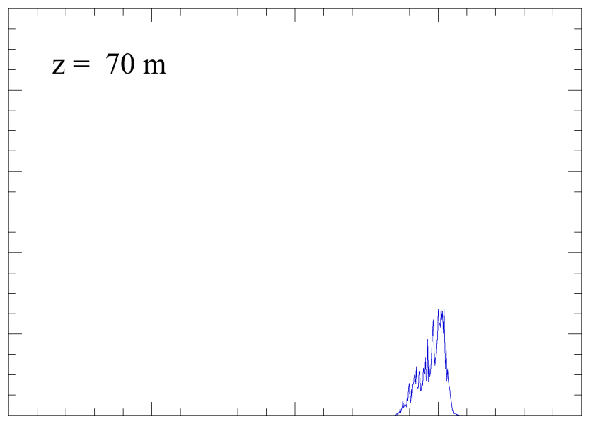
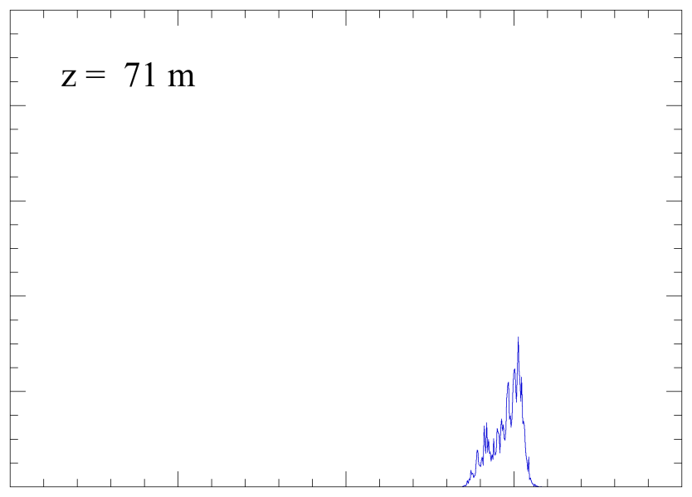
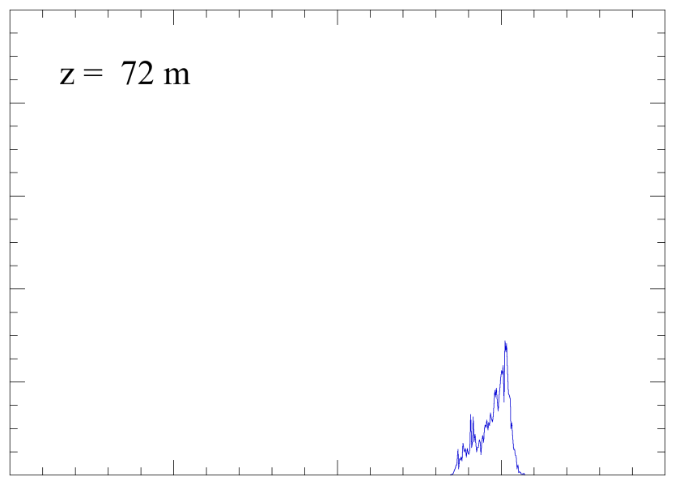

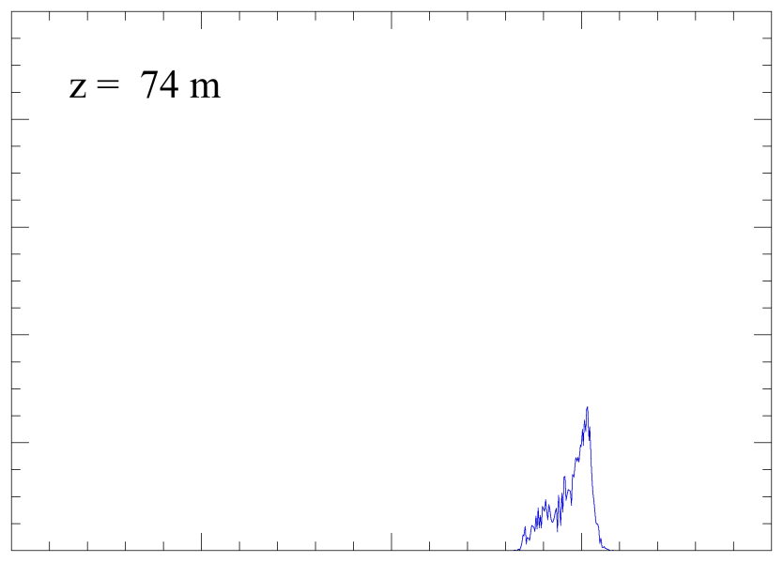
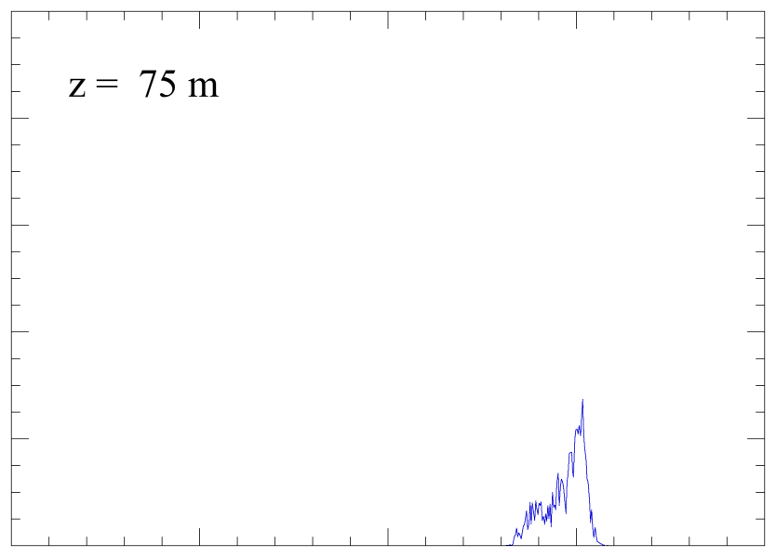


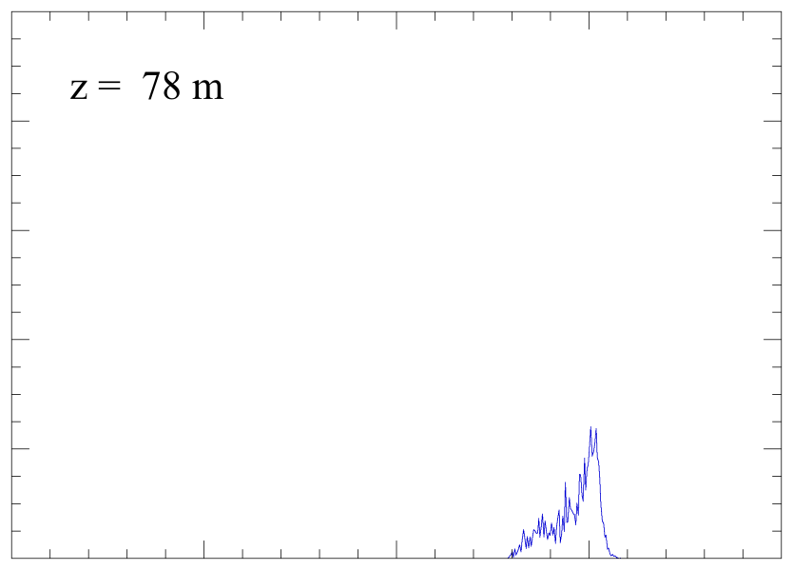

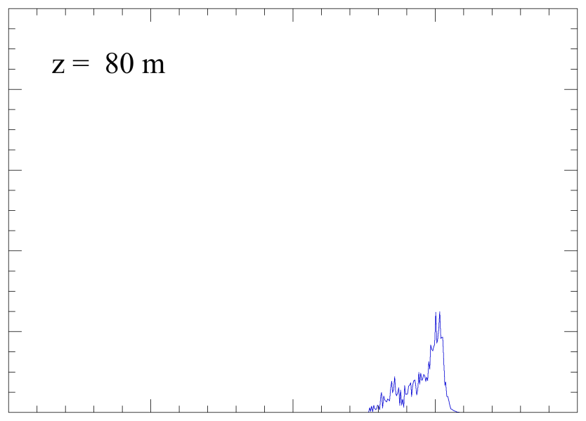

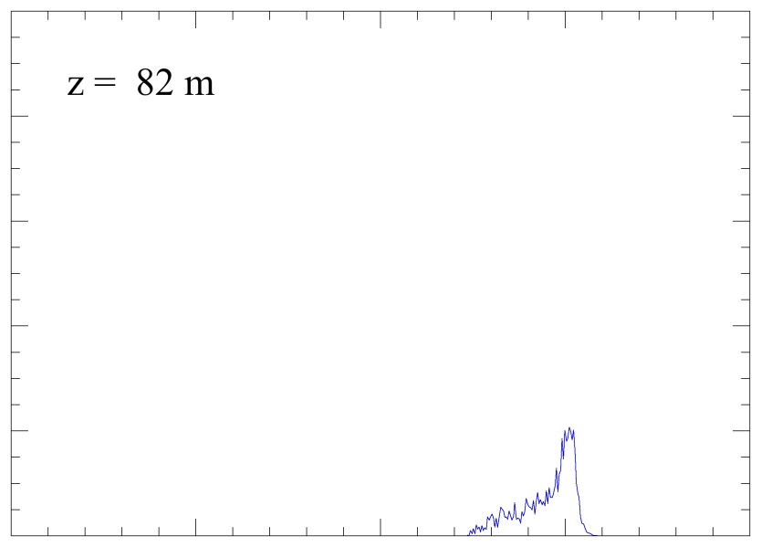
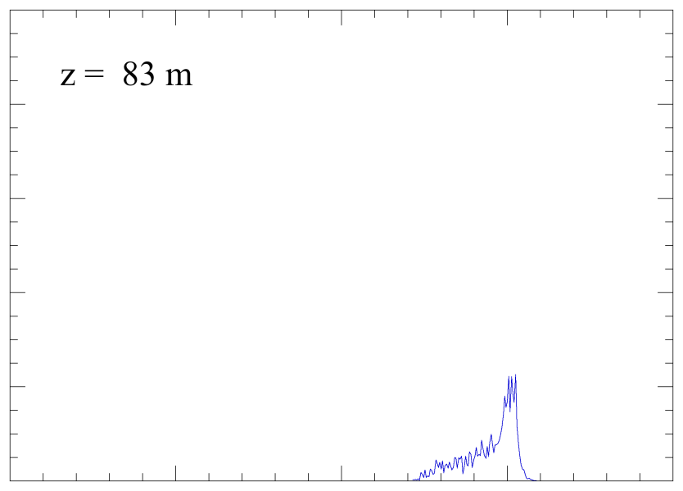
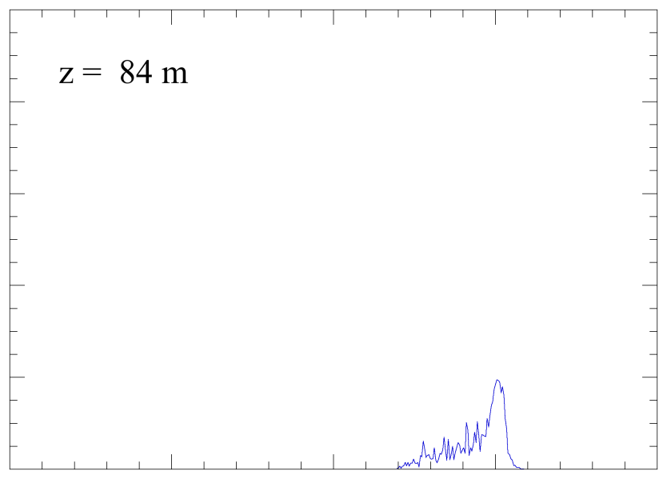
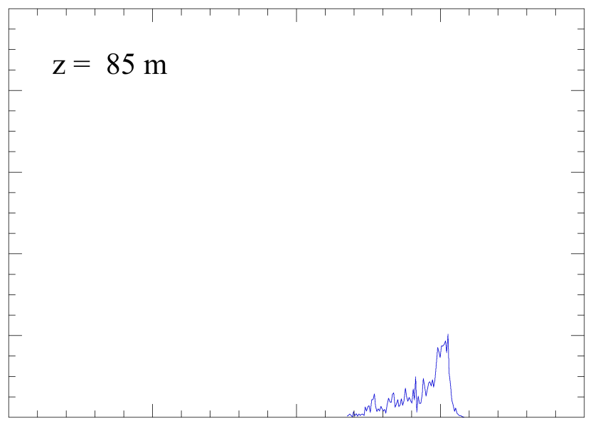

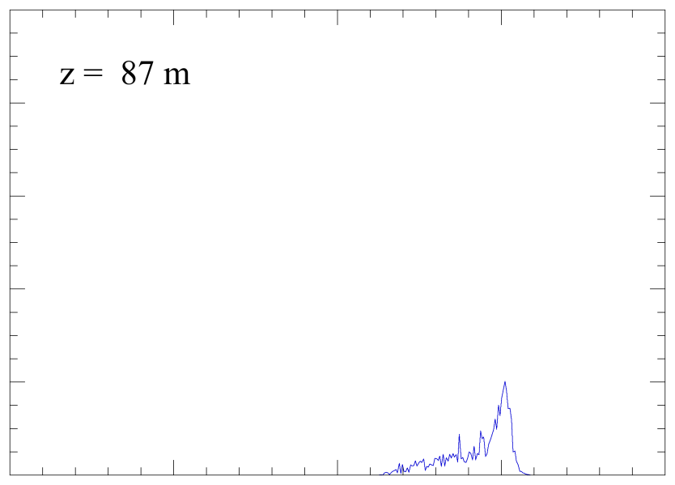
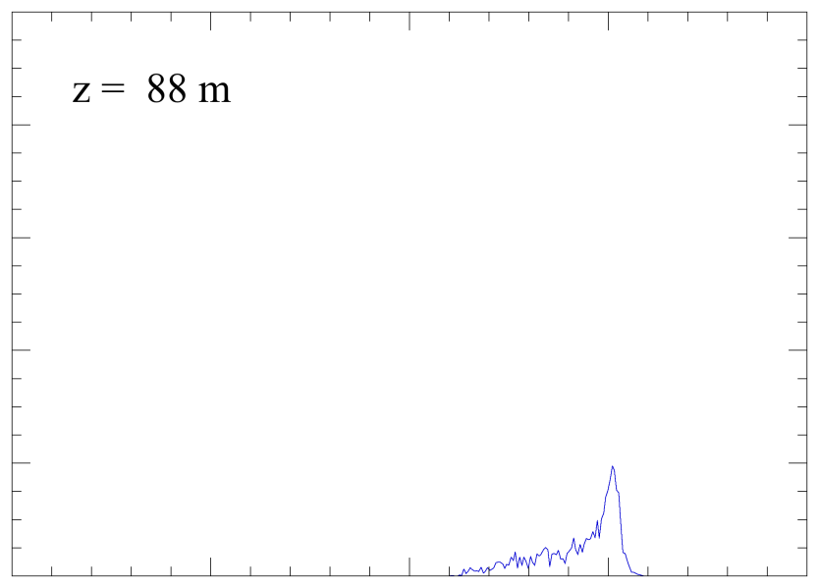




























Nonlinear undulator taper research is important to both MaRIE 1.0 baseline and advanced concepts
Nonlinear taper (10-14%) increases power by factor of ~ 40 (time-independent simulations)
Want the MaRIE 1.0 design to be upwardly compatible with 200-m undulator with a quadratic taper
GENESIS
Evolution of the Energy Distribution
MEDUSA
Slide 14

Slide 15

Emittance partitioning at 250 MeV
  75% scraping
  Chicane-based compressor to 3 psec
  250 pC
  ε_{x} = 0.1 μm
  ε_{y} = 0.1 μm
  “slice” ε_{z} < 0.9 mm by 50 keV = 90 μm
  10⁻⁶
  ε_{x} = 4.9 μm
  6 10⁻⁵
Slide 15

